Slide 1
Final Year Project Markson’s Memory
Conor Kelleher
13395381
Supervisor: Mark Keane

Slide 2
Markson’s Memory

Slide 3
Markson’s Memory
Digital Humanities

Slide 4
Markson’s Memory
Digital Humanities
Text Analytics

Slide 5
Markson’s Memory
Digital Humanities
Text Analytics
Natural Language Toolkit (NLTK)

Slide 6

Wittgenstein’s Mistress -David Markson

Slide 7
For example,
“I would perhaps find it difficult to think of anybody I would rather be descended from than Emily Bronte.
Unless Sappho, of course.
Well, or Helen.”

Slide 8
Close Reading

Slide 9
Close Reading vs. Distant Reading

Slide 10
Approach

Slide 11
Approach
Extract Repeated Phrases

Slide 12
Approach
Extract Repeated Phrases
Find Named Entities

Slide 13
Approach
Extract Repeated Phrases
Find Named Entities
Construct Networks

Slide 14
Approach
Extract Repeated Phrases
Find Named Entities
Construct Networks
Track Thought Patterns

Slide 15
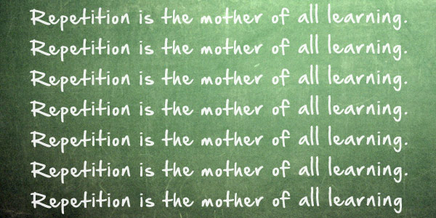
Finding Phrase Repetition

Slide 16
Phrase Extraction – N-Grams
“Why have I written that his name was Adam?

Slide 17
Phrase Extraction – N-Grams
“Why have I written that his name was Adam?
3-Grams: {“Why have I”, “have I written”, “I written that”, “that his name”, “his name was”, “name was Adam”}

Slide 18
Phrase Extraction – N-Grams
“Why have I written that his name was Adam?
3-Grams: {“Why have I”, “have I written”, “I written that”, “that his name”, “his name was”, “name was Adam”}
…
6-Grams: {“Why have I written that his”, “have I written that his name”, “I written that his name was”, “written that his name was Adam”}

Slide 19
Phrase Extraction – N-Grams
“Why have I written that his name was Adam?
3-Grams: {“Why have I”, “have I written”, “I written that”, “that his name”, “his name was”, “name was Adam”}
…
6-Grams: {“Why have I written that his”, “have I written that his name”, “I written that his name was”, “written that his name was Adam”}
…
9-Grams: {“Why have I written that his name was Adam”}

Slide 20

Named Entity Recognition

Slide 21
Finding Entities
“There was Cezanne, of course.
Although it was not Cezanne but was Renoir.”

Slide 22
Finding Entities
“There was Cezanne, of course.
Although it was not Cezanne but was Renoir.”

Slide 23
Finding Entities
What’s in a name?

Slide 24
Finding Entities
What’s in a name?
Knowledge-based (Rules)

Slide 25
Finding Entities
What’s in a name?
Knowledge-based (Rules)
Probability-based (Training Corpus)

Slide 26
Finding Entities
What’s in a name?
Knowledge-based (Rules)
Probability-based (Training Corpus)
Stanford NER (Named Entity Recognition)

Slide 27

Network
Analysis

Slide 28
Same-paragraph mentions

Slide 29

Same-paragraph mentions

Slide 30
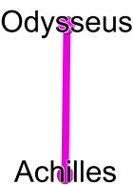
Same-paragraph mentions

Slide 31
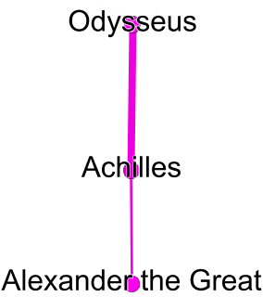
Same-paragraph mentions

Slide 32
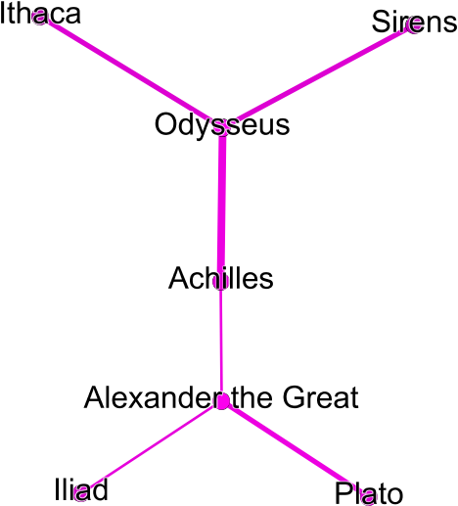
Same-paragraph mentions

Slide 33
Same-paragraph mentions

Slide 34
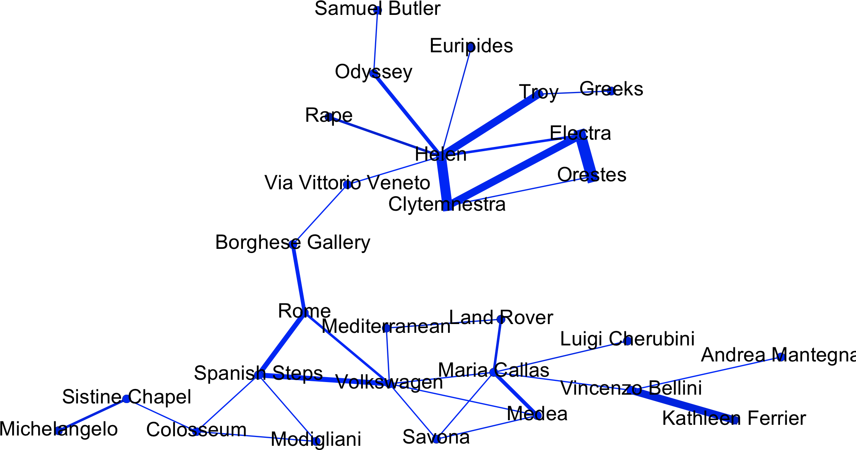
Same-paragraph mentions

Slide 35
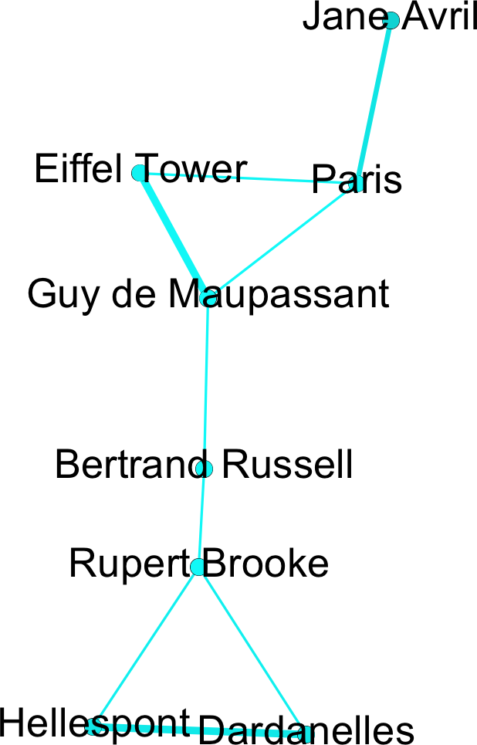
Same-paragraph mentions

Slide 36
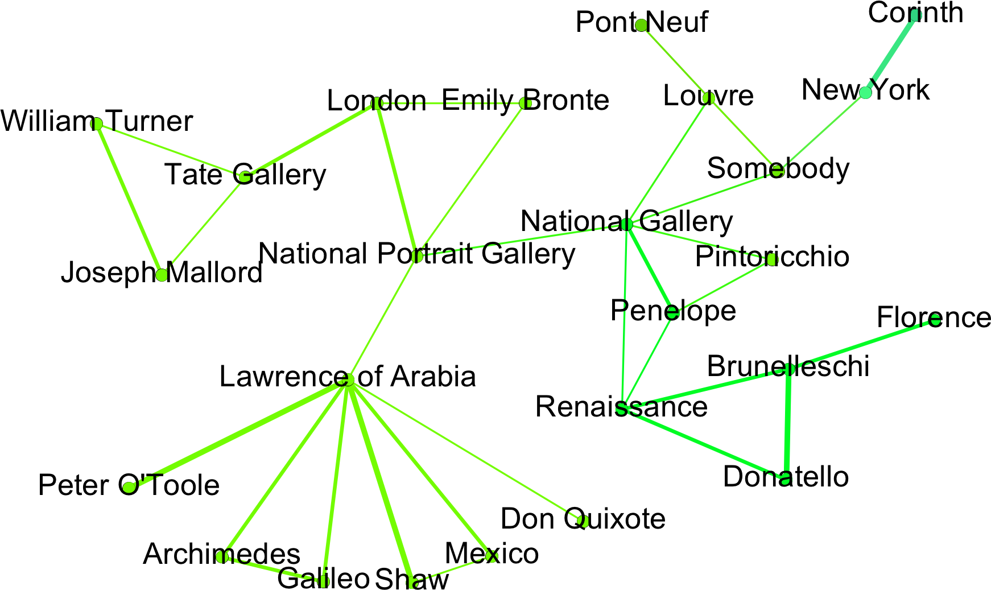
Same-paragraph mentions

Slide 37
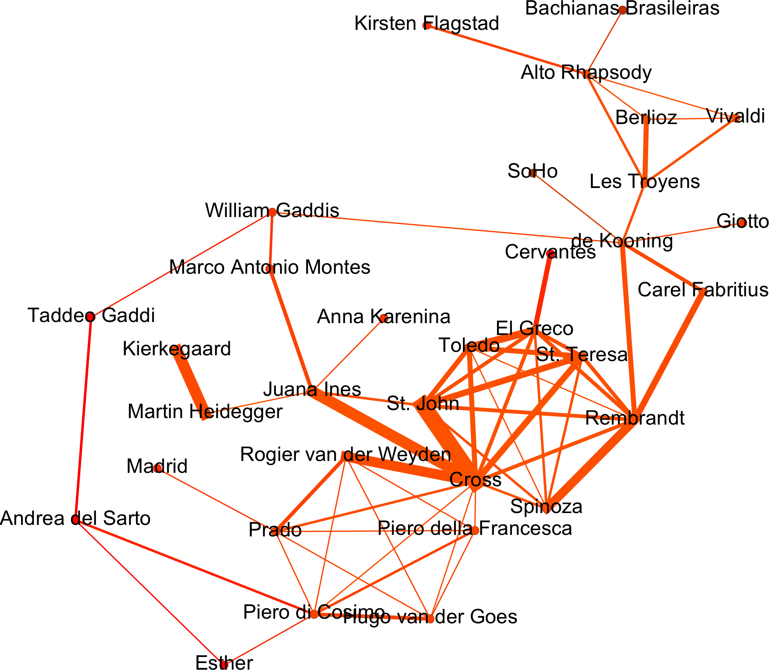
Same-paragraph mentions

Slide 38
One paragraph further…

Slide 39
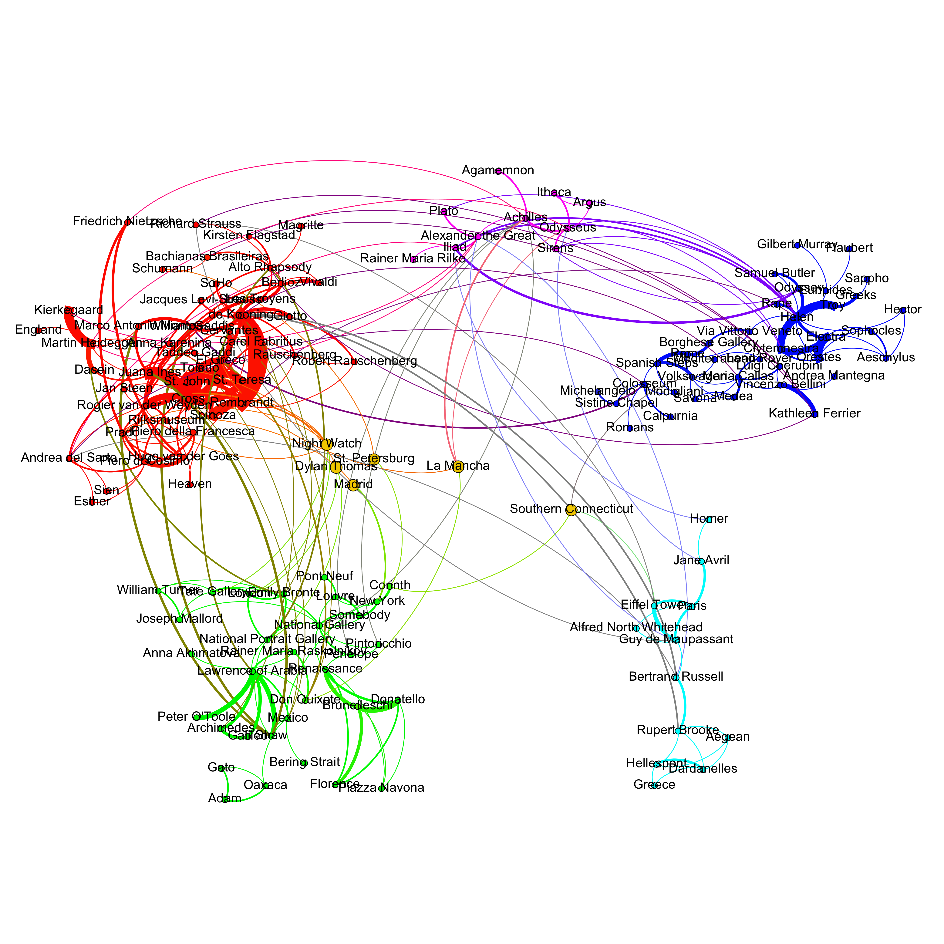
One paragraph further…

Slide 40
Order of Relationships / Associative Structure ?

Slide 41


A
Thought
Patterns
B
C

Slide 42
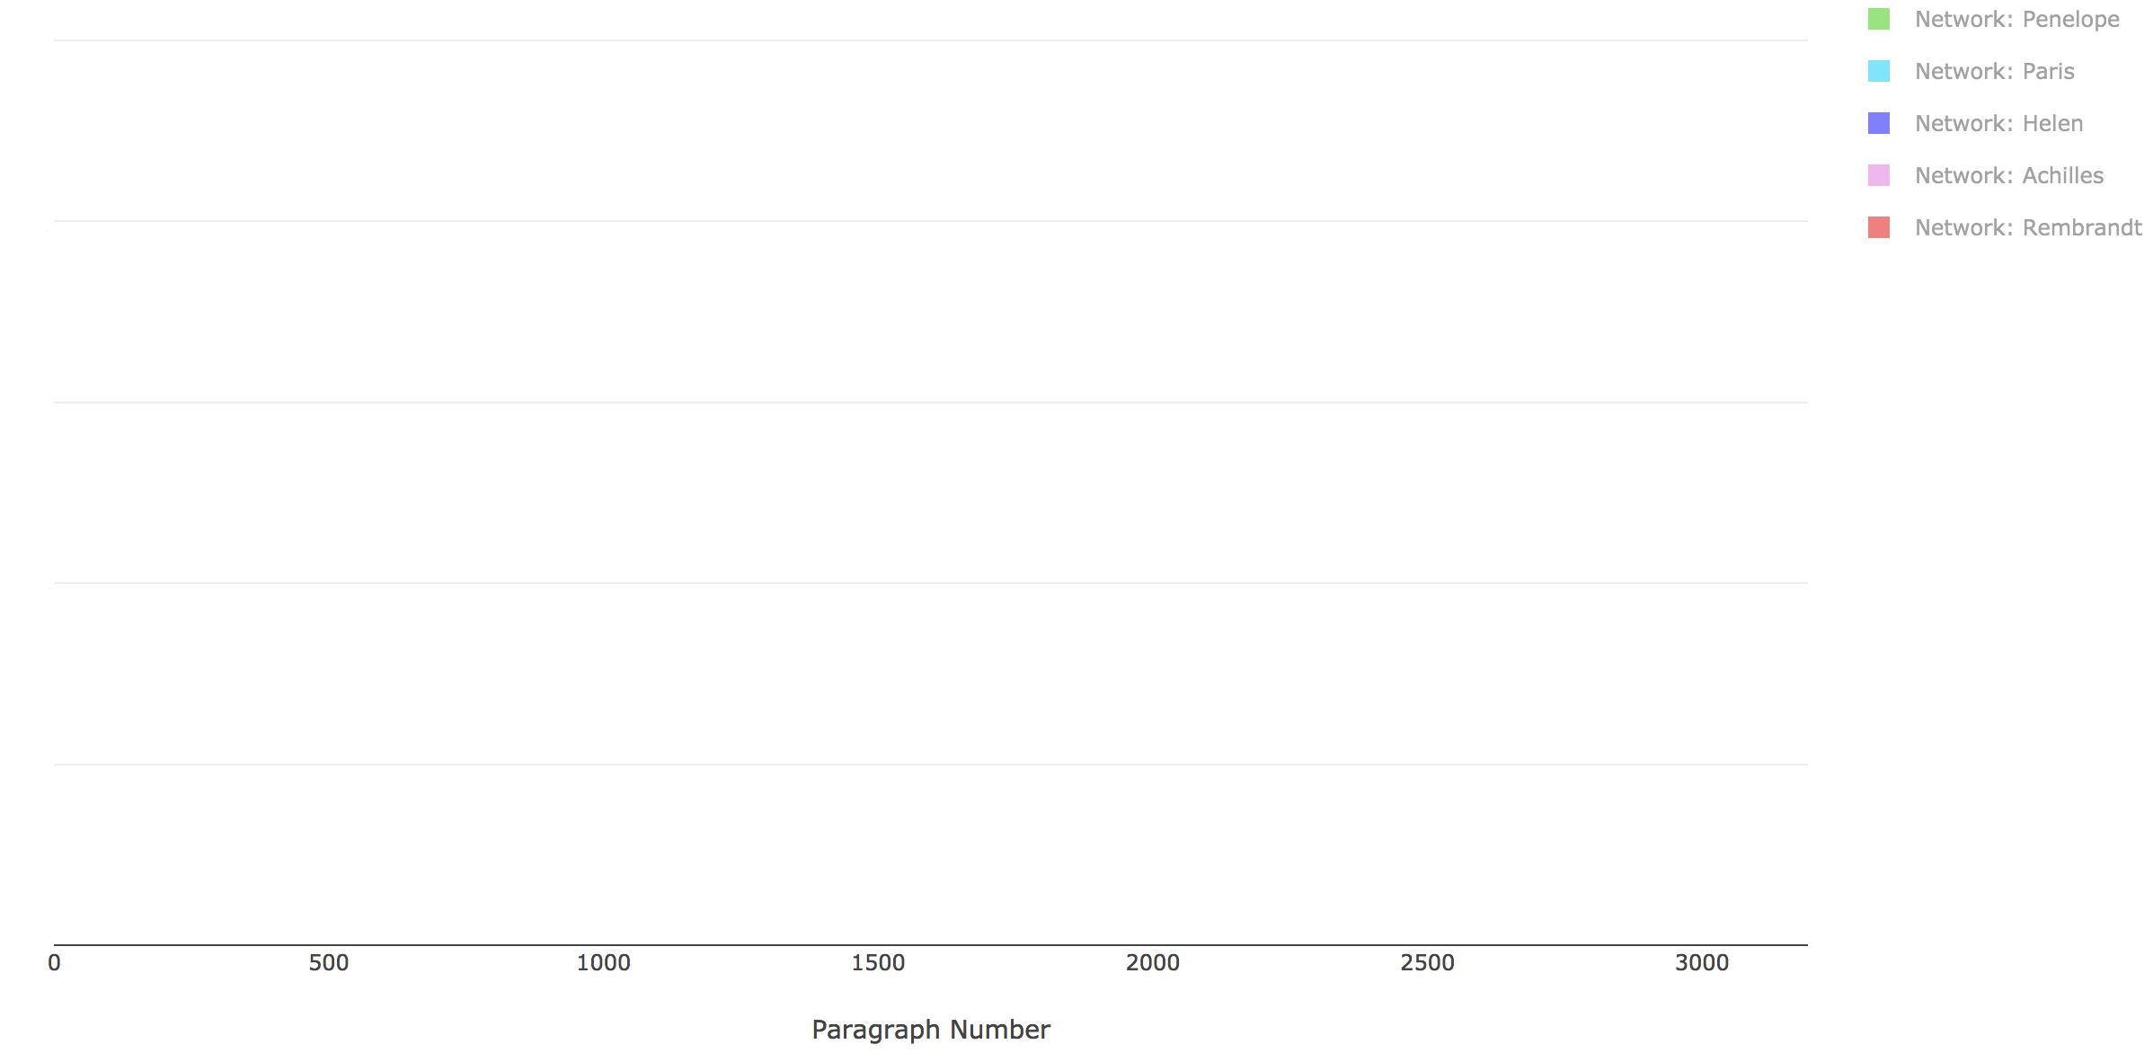
Adding a Timeline

Slide 43
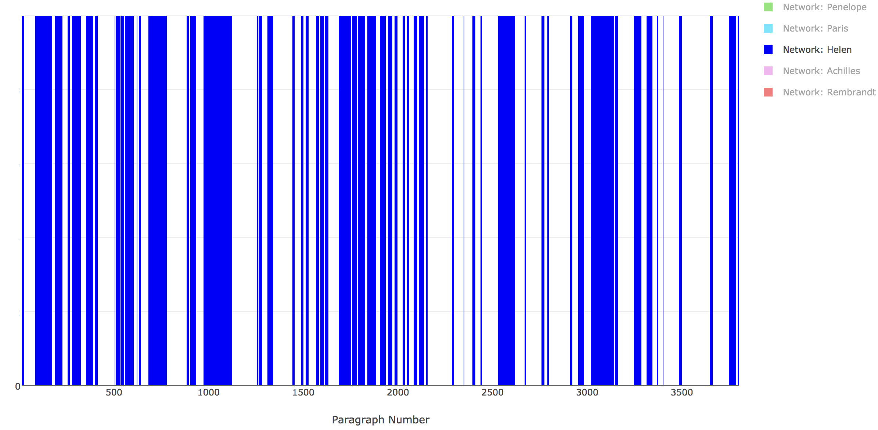
Adding a Timeline

Slide 44
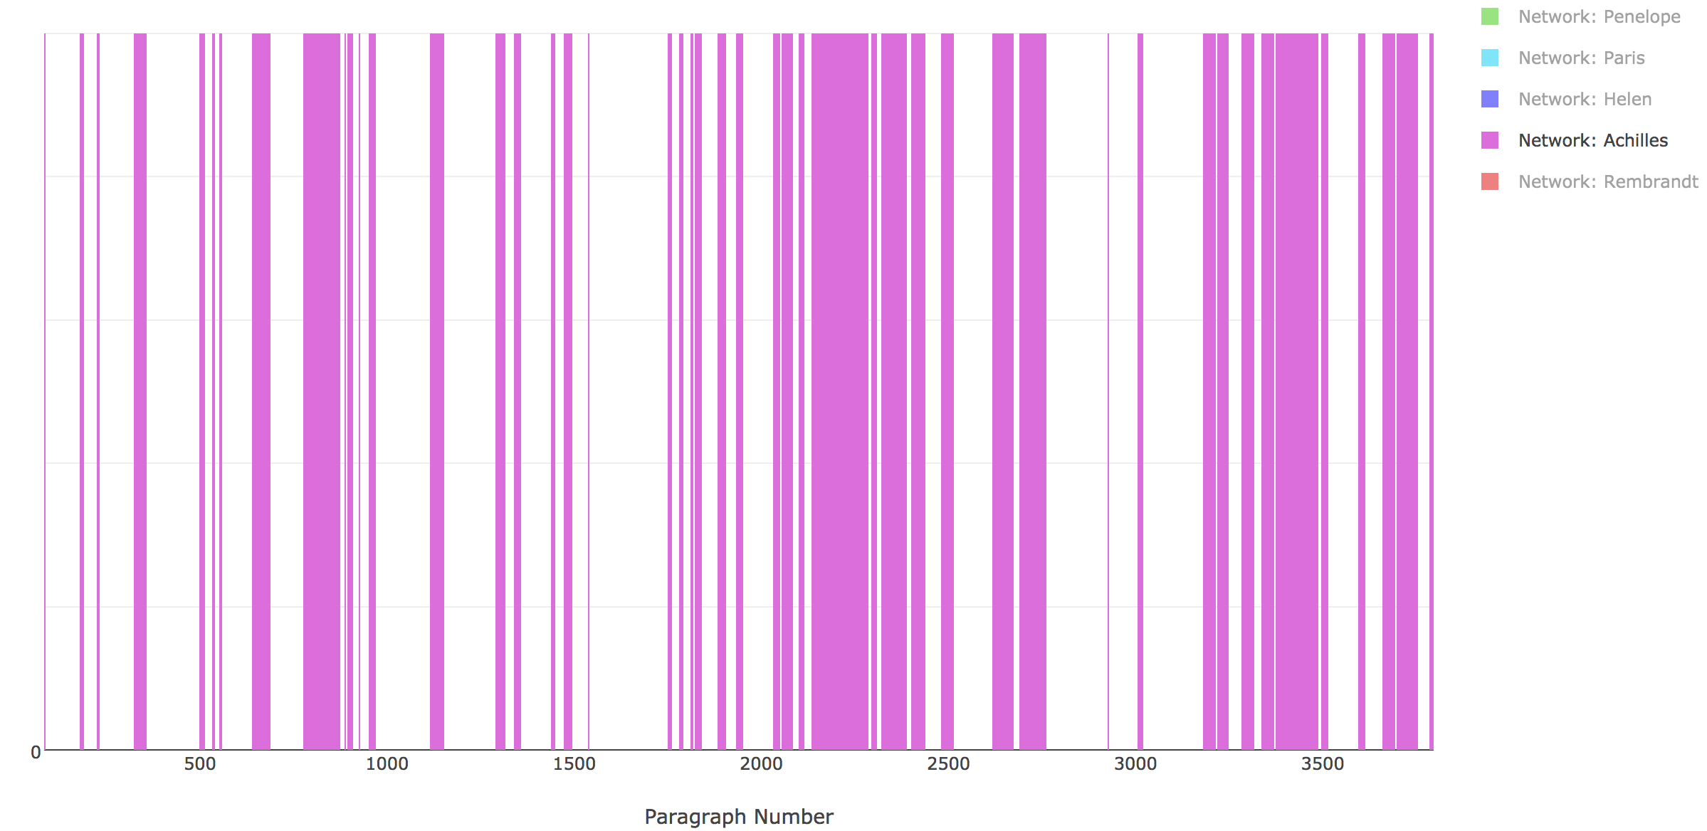
Adding a Timeline

Slide 45
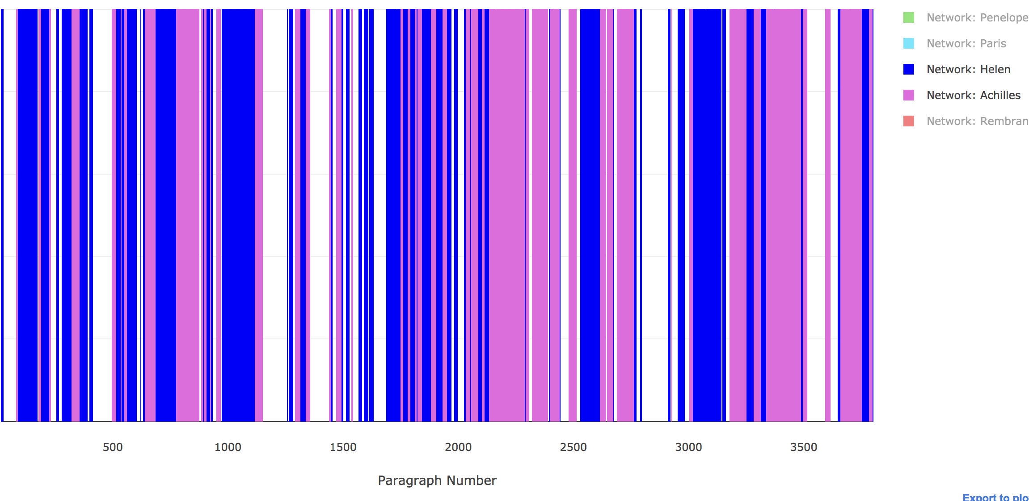
Adding a Timeline

Slide 46
Adding a Timeline
Pattern | Count
< 3, 2 > | 39
< 2, 3 > | 35
< 2, 3, 2 > | 24
< 3, 2, 3 > | 21
...
< 2, 3, 2, 3, 2, 3, 2, 3, 2 > | 4
< 3, 2, 3, 2, 3, 2, 3, 2, 3 > | 3
< 2, 3, 2, 3, 2, 3, 2, 3, 2, 3 > | 2
< 2, 3, 2, 3, 2, 3, 2, 3, 2, 0 > | 2
Networks
0: Penelope
2: Helen
3: Achilles

Slide 47
Conclusions

Slide 48
Conclusions
Distant Reading applicable to this text

Slide 49
Conclusions
Distant Reading applicable to this text
Significant Phrase-Repetition

Slide 50
Conclusions
Distant Reading applicable to this text
Significant Phrase-Repetition
Clear entity-association networks

Slide 51
Conclusions
Distant Reading applicable to this text
Significant Phrase-Repetition
Clear entity-association networks
Repeated thought-patterns

Slide 52
Conclusions
Distant Reading applicable to this text
Significant Phrase-Repetition
Clear entity-association networks
Repeated thought-patterns
Possible use in similar studies

Slide 53
Conclusions
Distant Reading applicable to this text
Significant Phrase-Repetition
Clear entity-association networks
Repeated thought-patterns
Possible use in similar studies
Generic algorithm

Slide 54
Conclusions
Distant Reading applicable to this text
Significant Phrase-Repetition
Clear entity-association networks
Repeated thought-patterns
Possible use in similar studies
Generic algorithm
Clear, quickly generated visuals

Slide 55
Questions?
conor.kelleher.1@ucdconnect.ie
Conor Kelleher
BSc. Computer Science

Slide 56
Sample Paragraph Structure
I have no idea how long ago it was when I was doing that. If I were forced to guess, I believe I would guess ten years.
Possibly it was several years longer ago than that, however.
And of course I was quite out of my mind for a certain period too, back then.

Slide 57
Phrase Extraction – Significant Phrases Only
“Why have I written that”
”Why have I written”
”have I written”
“Why have I”
“have I”

Slide 58
Phrase Extraction – Significant Phrases Only
“Why have I written that”
”Why have I written”
”have I written”
“Why have I”
“have I”

Slide 59
Phrase Extraction – Significant Phrases Only
“Why have I written that”

